Slide 1
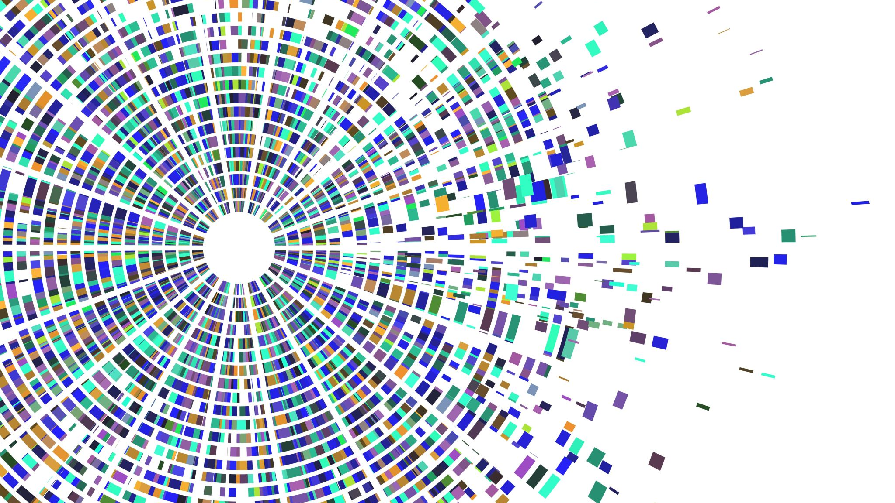

Group 2 :
SpikeVar & TykeVar
Simulation of Mosaic Variants
in Sequencing Data
Farhang Jaryani,
Fritz Sedlazeck, Lab
Human Genome Sequencing Center
Baylor college of Medicine

Slide 2
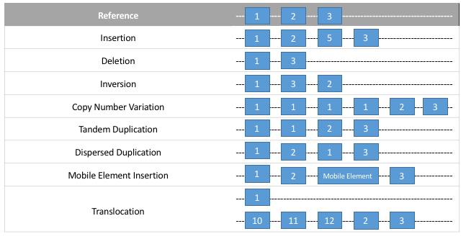
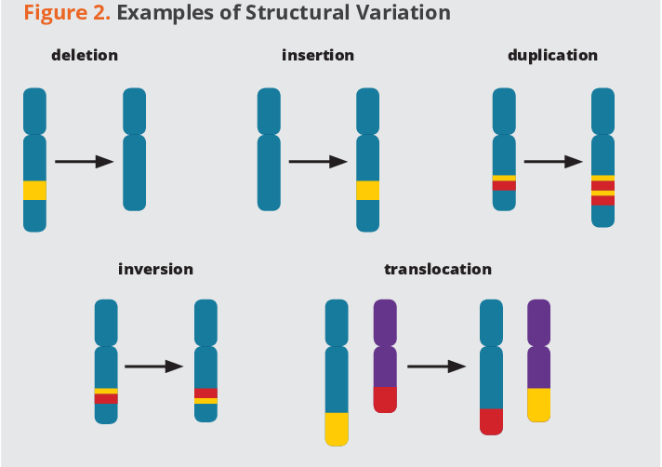
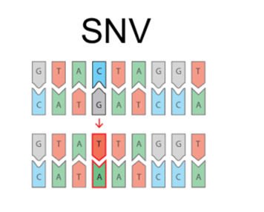
Structural Variants
HUNTING STRUCTURAL VARIANTS , Luke Hickey
https://api.semanticscholar.org/CorpusID:204805198
Notes:
Structural variants (SVs) are alterations in the DNA sequence that involve segments of DNA that are larger than 50 base pairs. These alterations can include deletions, duplications, insertions, inversions, and translocations. SVs can have significant impacts on the genome, potentially leading to genetic diseases or contributing to evolutionary changes. They are important to study in genomics research for understanding genetic diversity and disease mechanisms. SNV stands for Single Nucleotide Variant. It refers to a type of genetic variation involving a single nucleotide base change within the DNA sequence. These variants can influence traits, diseases, and other biological characteristics.

Slide 3
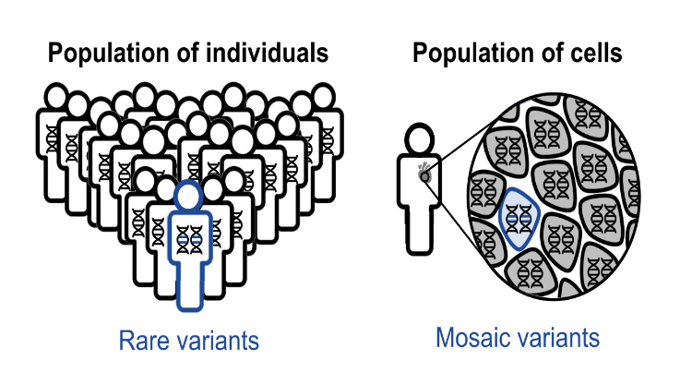
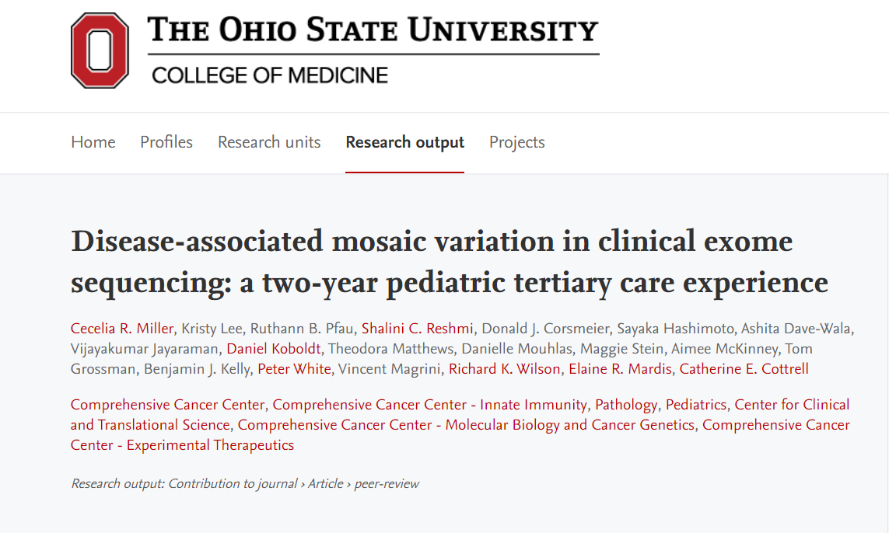
Mosaic Variants
Mosaic Variants:
Potentially associated with disease
Mixed in sequence data
Requires mosaic variant callers to detect
Disease-associated mosaic variation in clinical exome sequencing: a two-year pediatric tertiary care experience. Cold Spring Harb Mol Case Stud. 2020;6(3). Epub 20200612. doi: 10.1101/mcs.a005231. PubMed PMID: 32371413; PMCID: PMC7304353.
Notes:
rare variants only present in a small fraction of the cells are defined as mosaic variants (MVs)². Recent studies have shown that there is potential disease associations of for certain MVs^{2.} These mutations lead to differences in genetic makeup among cells in various parts of the body. Mosaic variants are significant in genetics research as they can influence disease manifestation, diagnosis, and treatment.

Slide 4
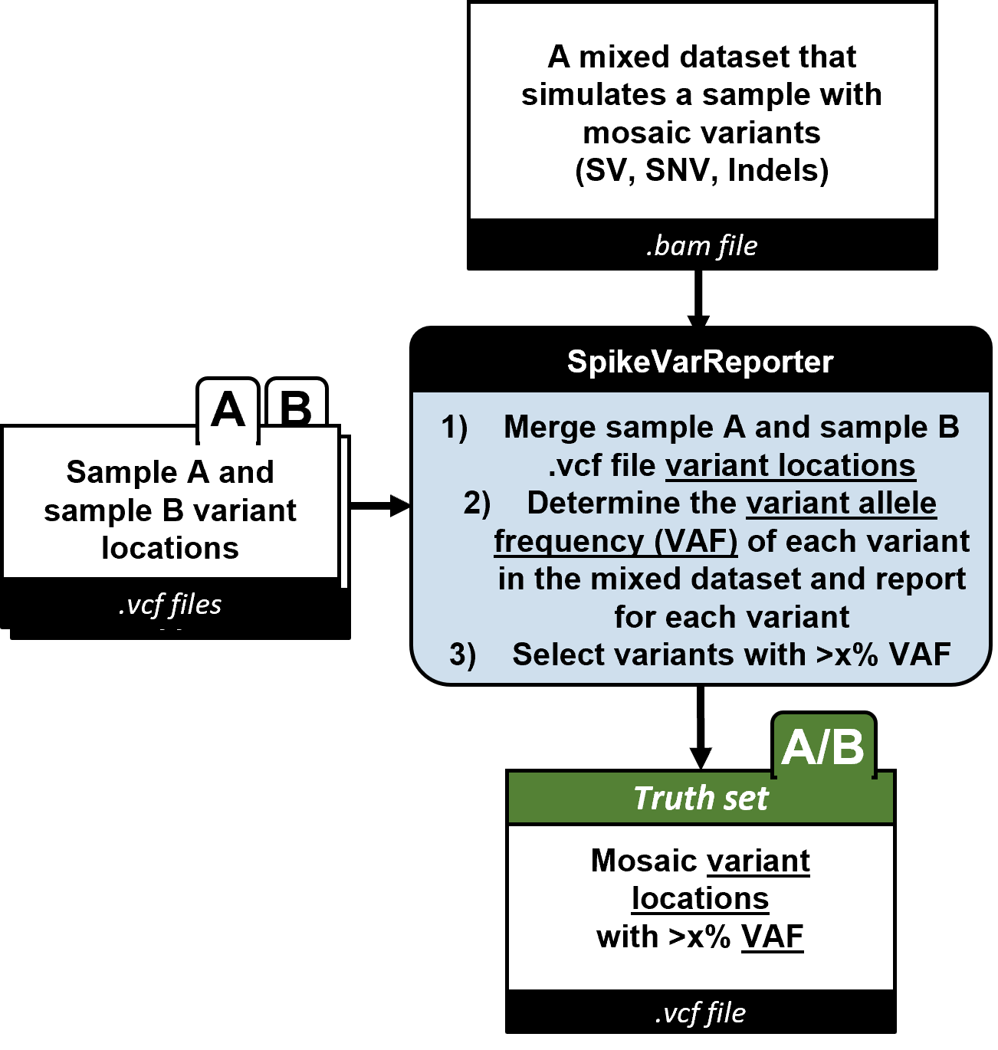
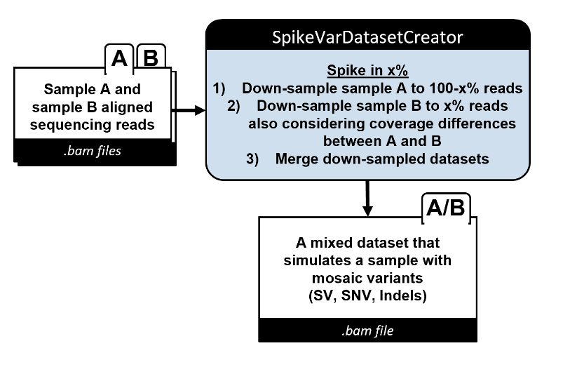
Spike in Known Exogenous Variants
Introducing User-Defined Spiking in Sequencing Data
SpikeVar DatabaseCreator –
Generate Spiked-in Dataset
2) SpikeVarReporter –
Filter Reads After Variant Allele Frequency Recalculation
Notes:
We developed two simulation workflows which output sequencing read files with artificial MVs and a ground truth annotation file for the MVs. SpikeVar accomplishes this by spiking in real reads from a sample at user-defined ratio into the sequencing file from a second sample. After creating the new BAM file from e.g. HG002 and HG00733, we have to re-calculate the variant allele frequency (VAF) for all variants. First we merge both VCF files from e.g. HG002 and HG00733 with bcftools. Depending on the variants we either start a SNV or SV caller, which can recalculate the VAF of each variant. For SNVs we are using bcftools mpileup. For SVs and short read data we are using Paragraph from Illumina and for long read data Sniffles2 is used. For example, heterozygous variants will not be represented by 5% VAF but rather at ~2.5% VAF. To account for this we re-genotype variants and report only variants that should be identifiable at the user-defined threshold or higher VAF.
./2b_re-genotyping_main.sh <VARIANT> <VAF> <sampleA.vcf> <sampleB.vcf> <sampleAandB.bam> output/path <ref.fa> <short|long>

Slide 5
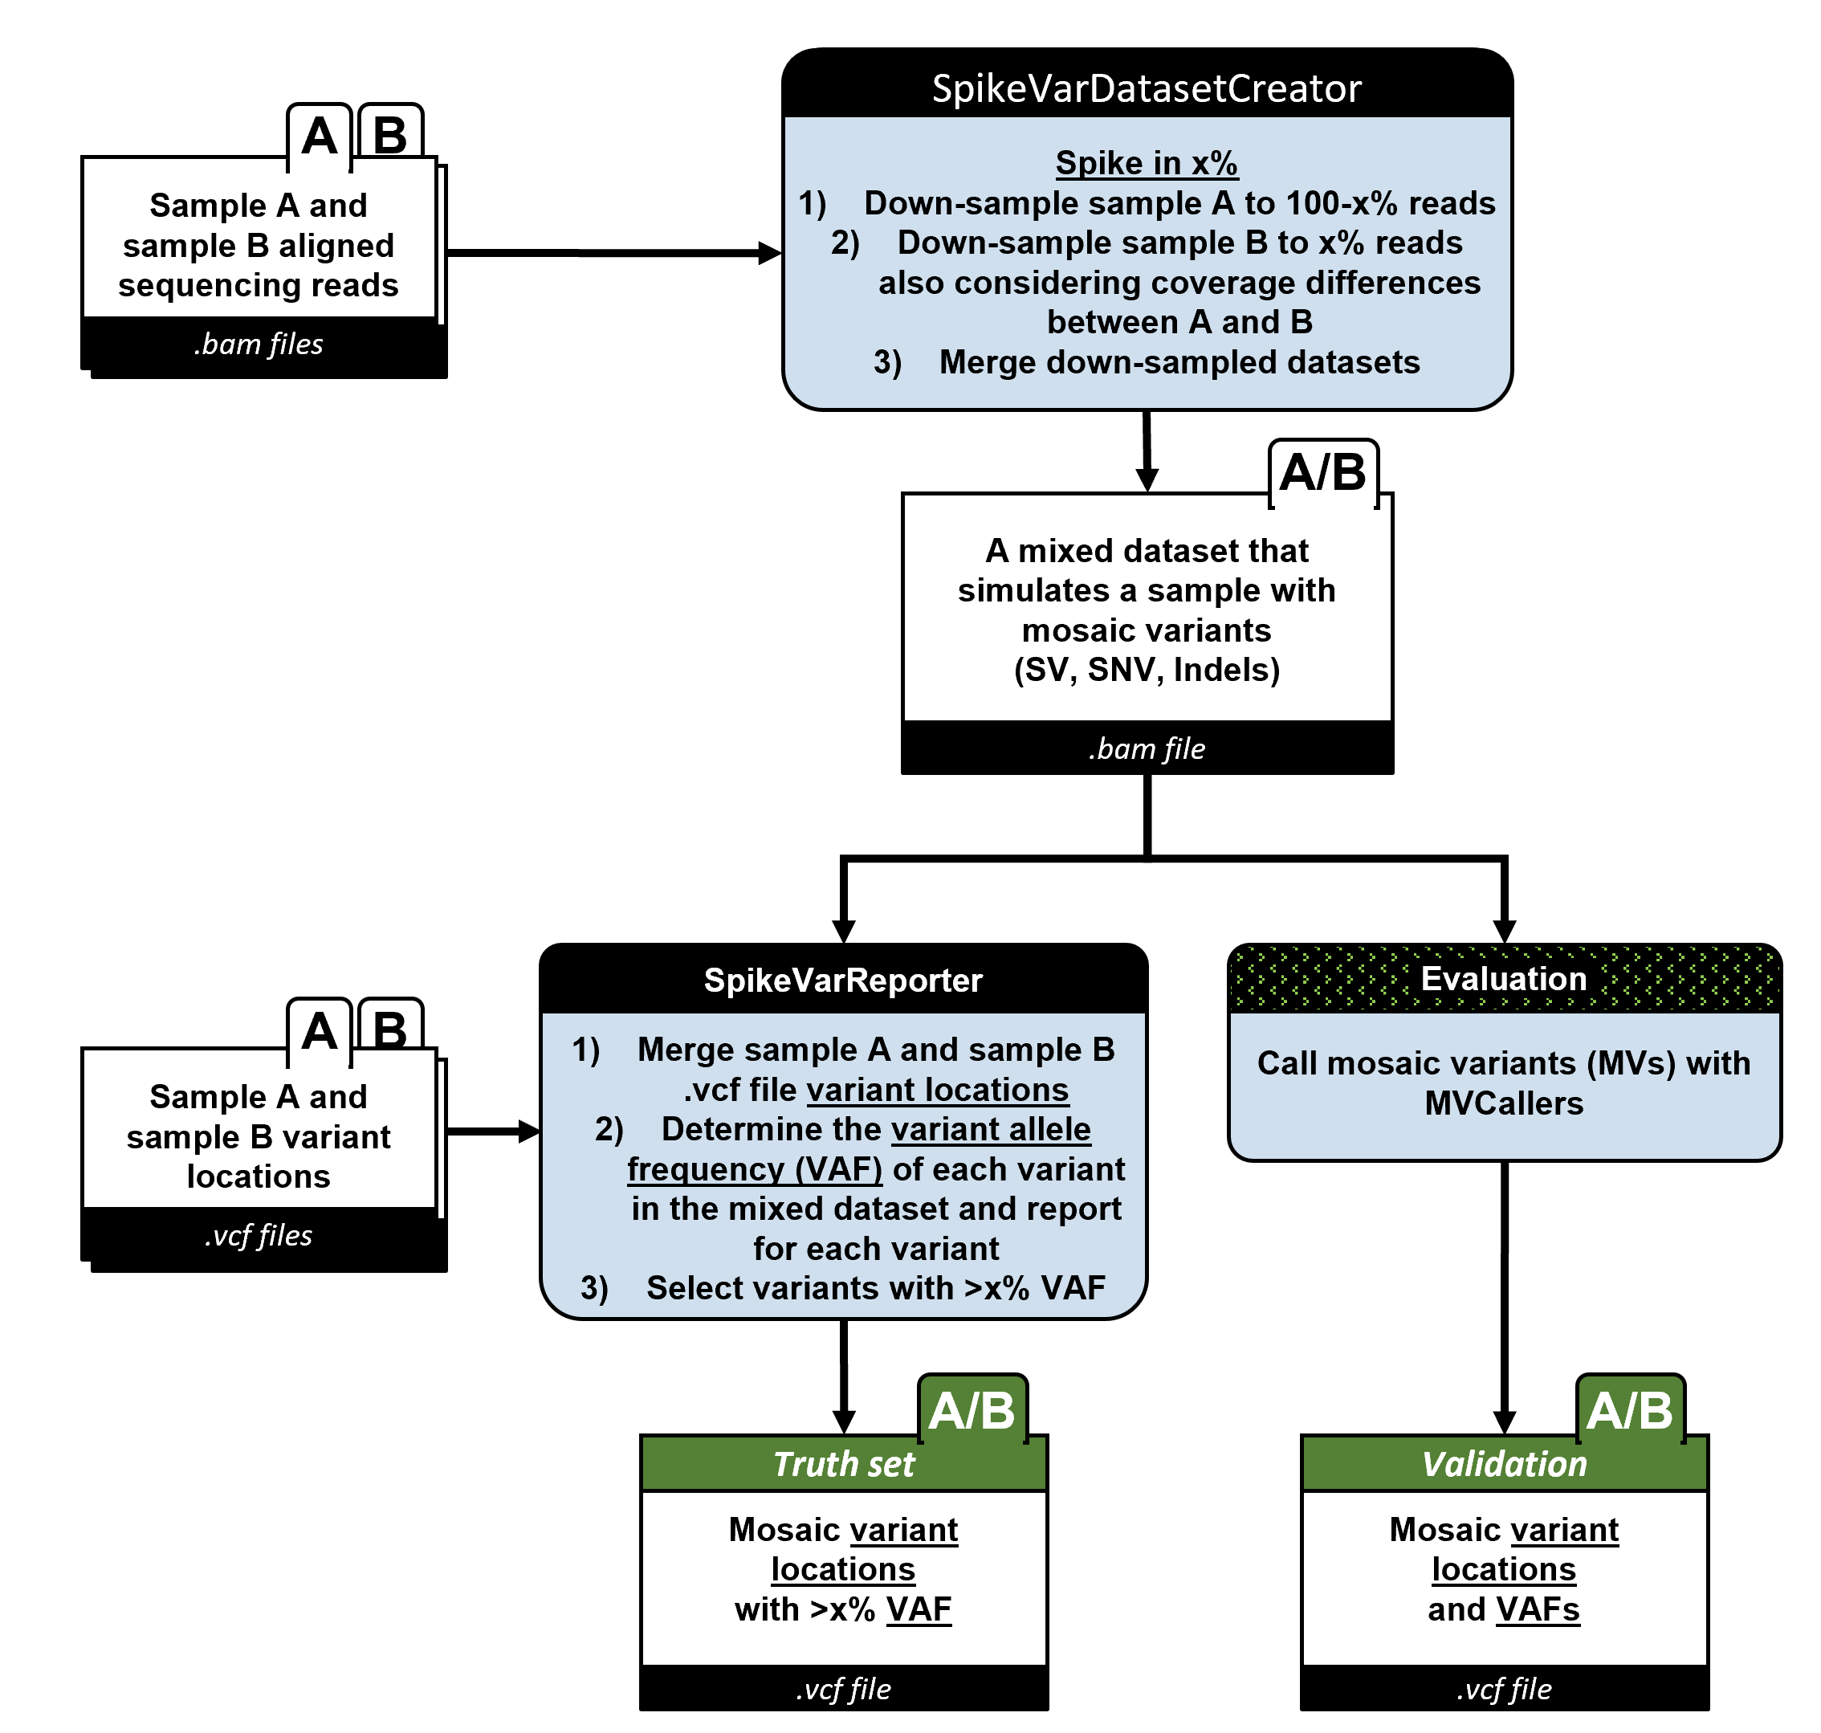
Spike in Known Exogenous Variants

Slide 6
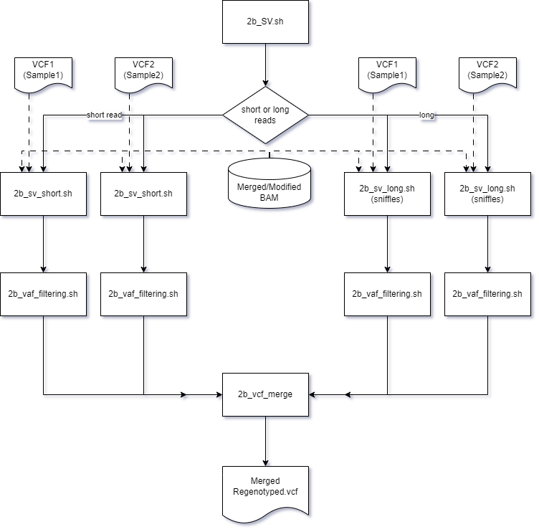
Spike in Known Exogenous Variants
Flowchart of re-genototyping both short and long reads SVs based on the modified generated bam file

Slide 7
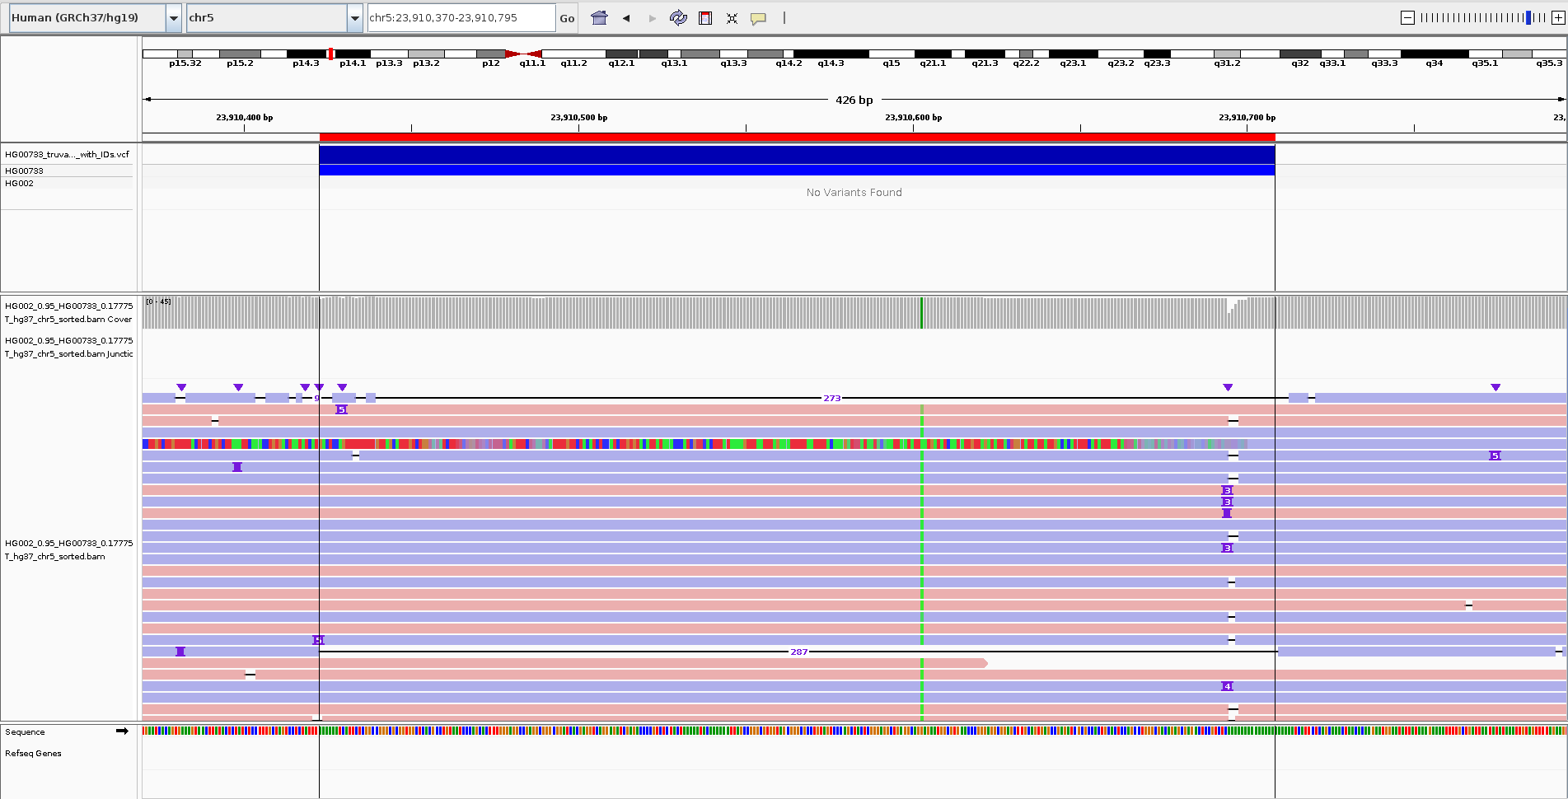
Spike in Known Exogenous Variants
Example of a spiked in deletion.

Slide 8
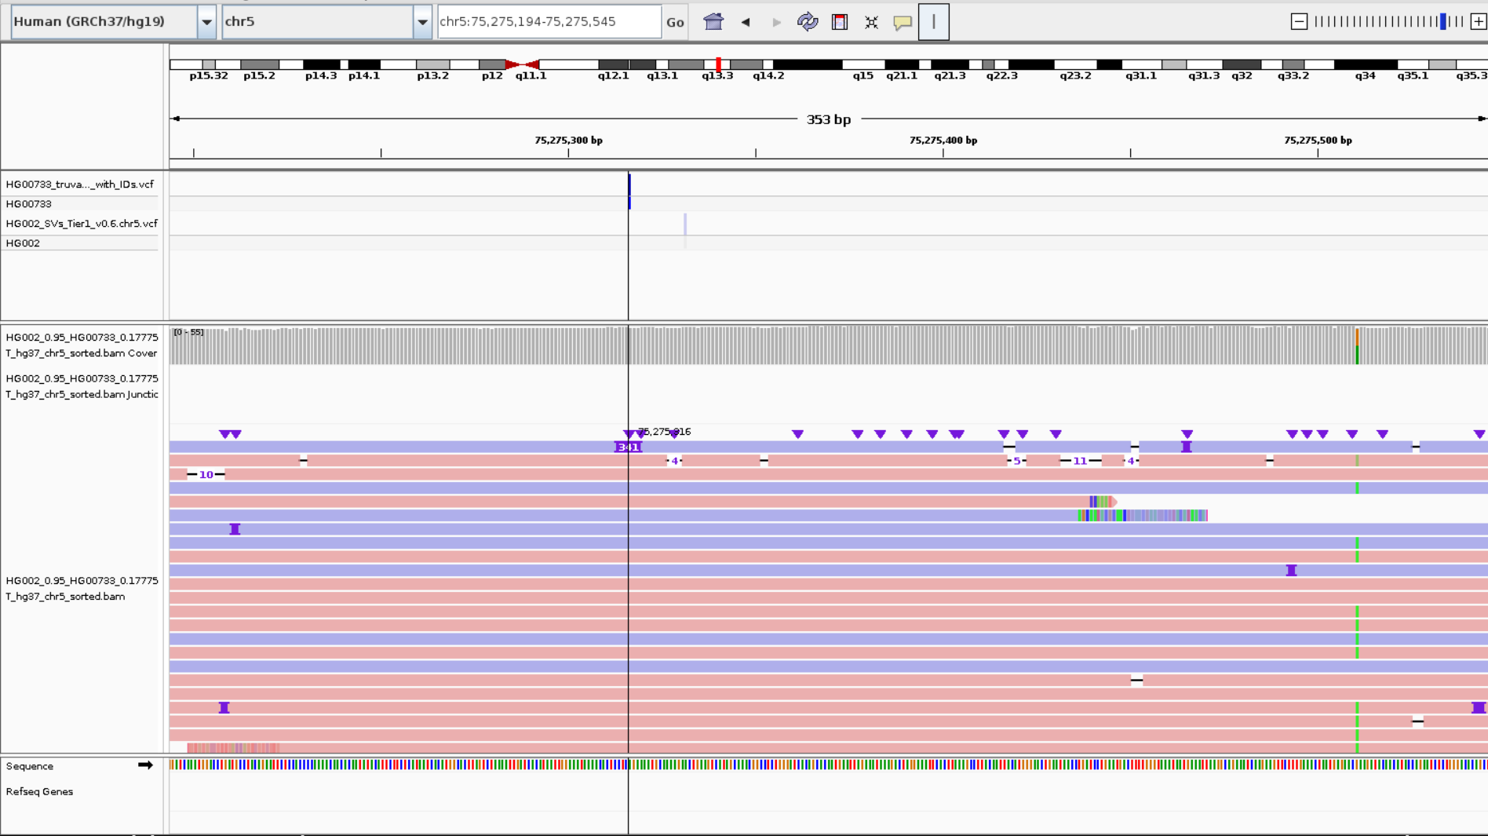
Spike in Known Exogenous Variants
Example of a spiked in insertion.

Slide 9
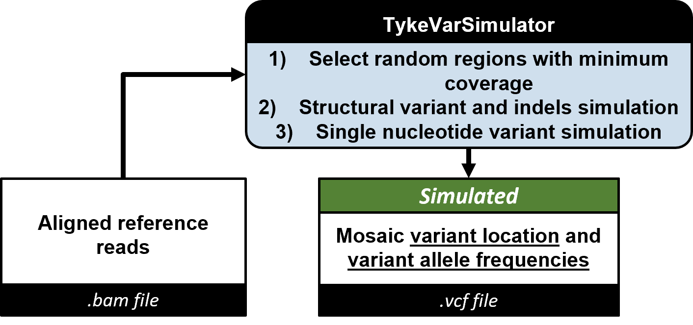
Track in Your Key Endogenous Variants
creates a list of random mutations
modifies a fraction of existing reads to match the user-defined MV frequency
1) TykeVarSimulator – Generate Simulated VCF
#CHROM POS ID REF ALT QUAL FILTER INFO FORMAT SAMPLE
chr22 34898635 HackDel1 N <DEL> 60 PASS AF=0.12;END=34902269;PRECISE;SVLEN=-3634;SVTYPE=DEL GT:GQ 0/0:60
chr22 32562272 HackIns1 N CGGCCTTGGAACTTTAACCATCTGTCCACTACGTTGTACATATTCATCTTCGTCTAGCCAAAGGCGAACCCGTCCTGGAATCTATATTACCTTTTTATGCCGCG>
chr22 42134824 HackIns2 N CCCCAGTGCTCAATCCATTCTCGTTTTTTGGTGGACCTCGGCGTTCGAGTAGGCTTTGATGTACGGTCTTCTCAGTTATAGATGCCTCGTGAGGCCCGCCGTTT>
chr22 43938337 HackIns3 N CTCTAGAGAGTCGGGACCCGGTCGTGCTATTATCTAAACGCGTAATGCTTACACTGCAATGTACGTGGCTTAGGCATTTCGCGATACTTGAGTACCTAGACCTA>
chr22 43366574 HackDel2 N <DEL> 60 PASS AF=0.07;END=43375935;PRECISE;SVLEN=-9361;SVTYPE=DEL GT:GQ 0/0:60
Notes:
In contrast, TykeVar creates a list of random mutations and modifies a fraction of existing reads to match the user-defined MV frequency. The VCF simulator generates a random set of mosaic variants (SNVs and SVs). The variants can be parameterized with VAF, the number of variants to simulate, and the size of the variations.

Slide 10
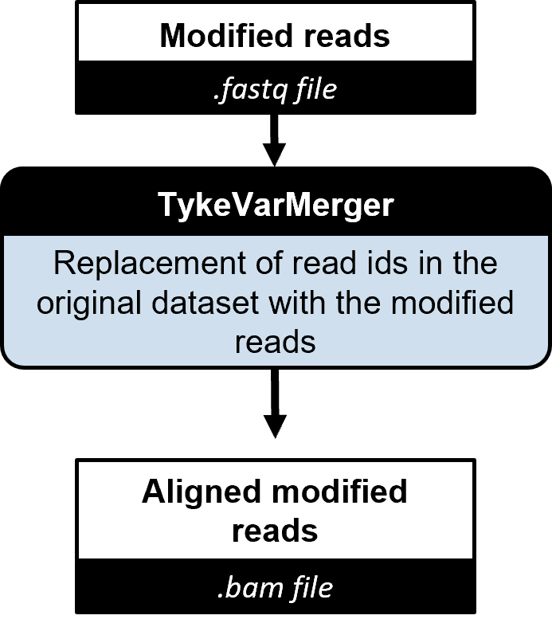
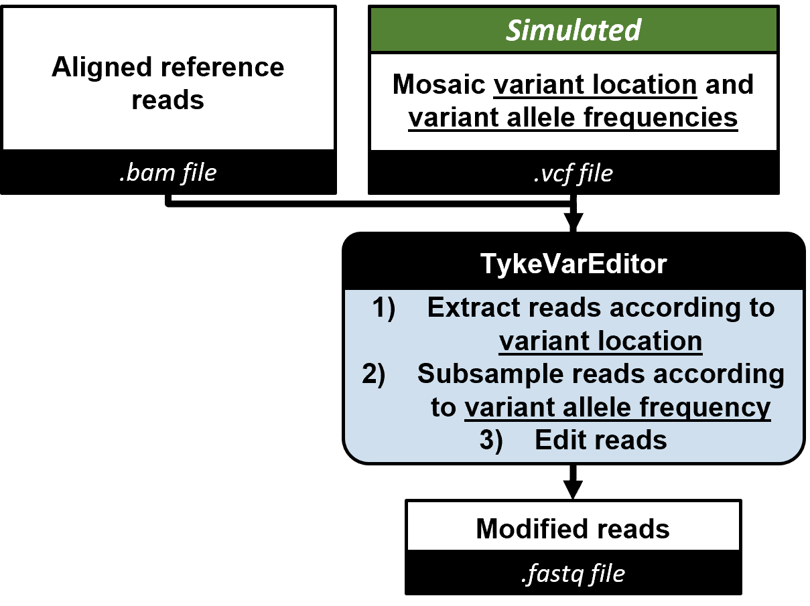
Track in Your Key Endogenous Variants
3) TykeVarMerger – Re-Align Modified Reads and Merge Them
2) TykeVarEditor – Generate Edited Reads Based on Simulated VCF
Notes:
The variants generated here act as an input into the read editor step (described below) which produces modified reads with the variants inserted into them. The same VCF file is also the ground truth for evaluating mosaic variant callers.
This module above takes in the VCF which determines which variants to introduce into the reads. The BAM file is used to find the reads which overlap with variant locations. Only a subset of the reads corresponding to a particular variant location are edited. This is determined by the allele frequency. The output FASTQ file has the edited reads. The query name of each read is kept the same.

Slide 11
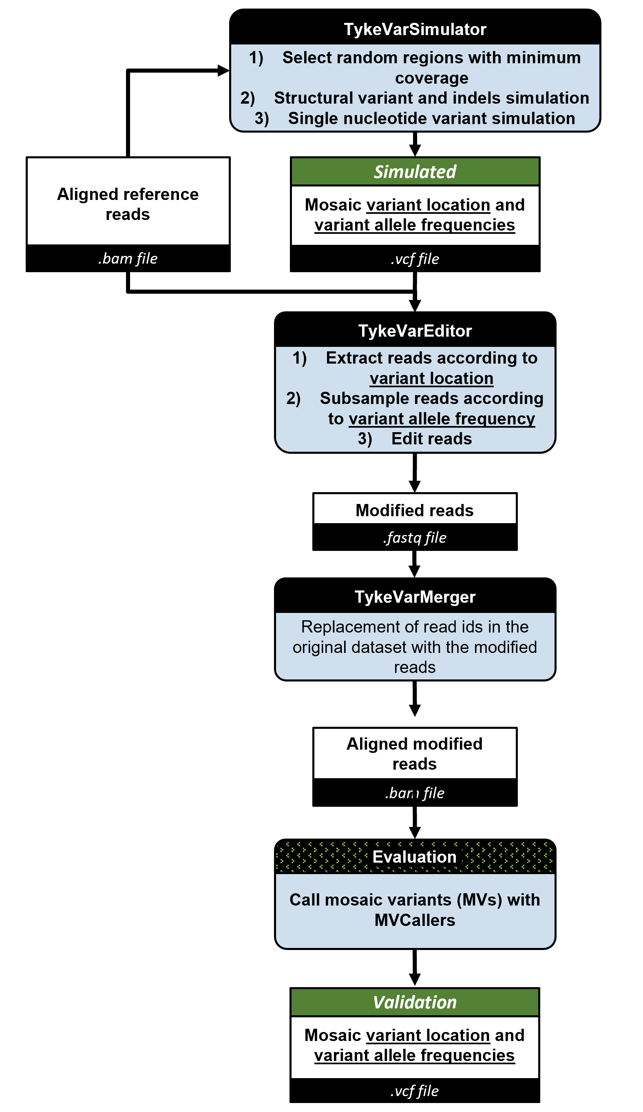
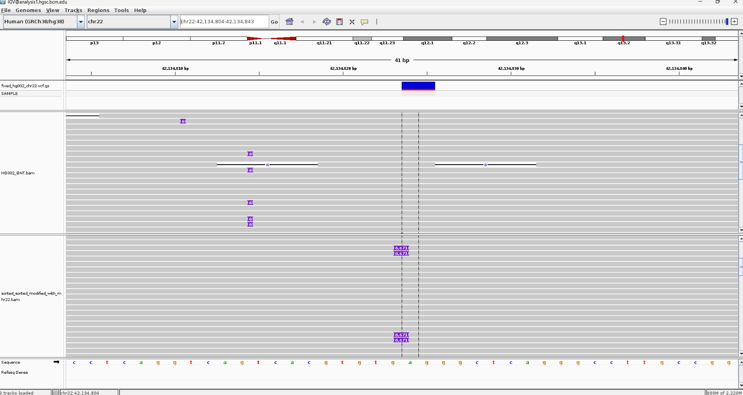
TykeVar – Creation of Sequencing Data With a Subset of Modified Reads
A mosaic SV insertion.

Slide 12
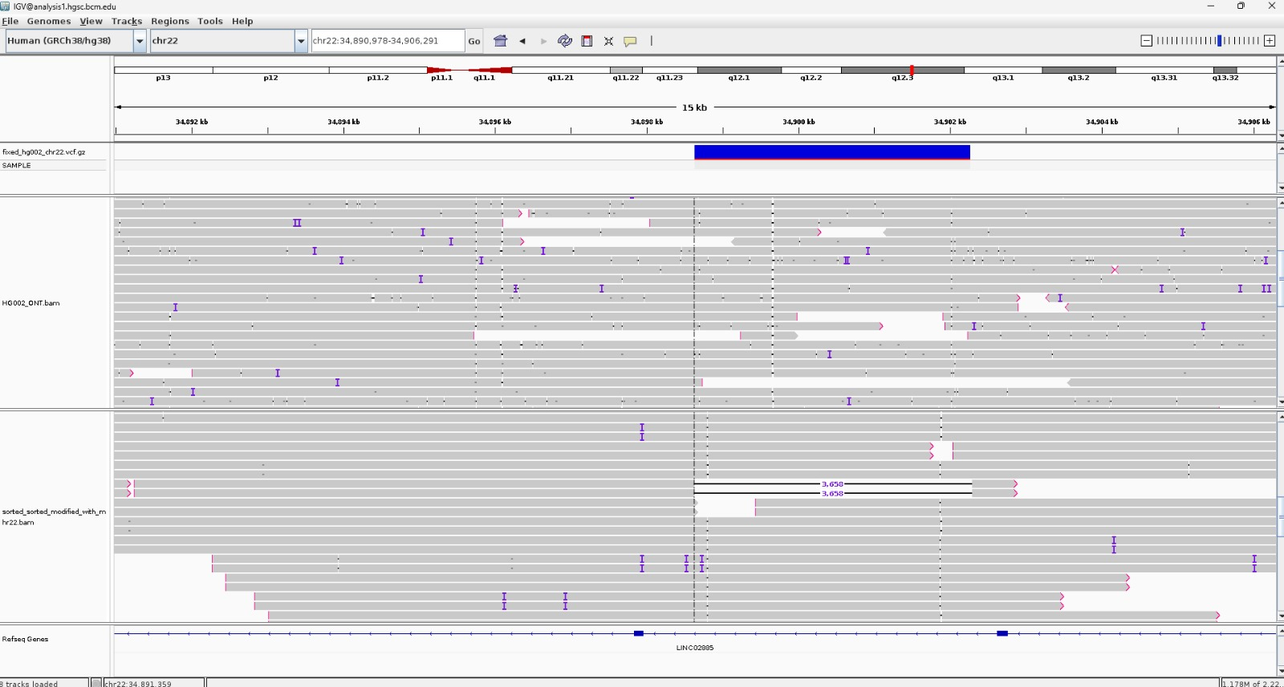
Track in Your Key Endogenous Variants
A mosaic SNP.

Slide 13
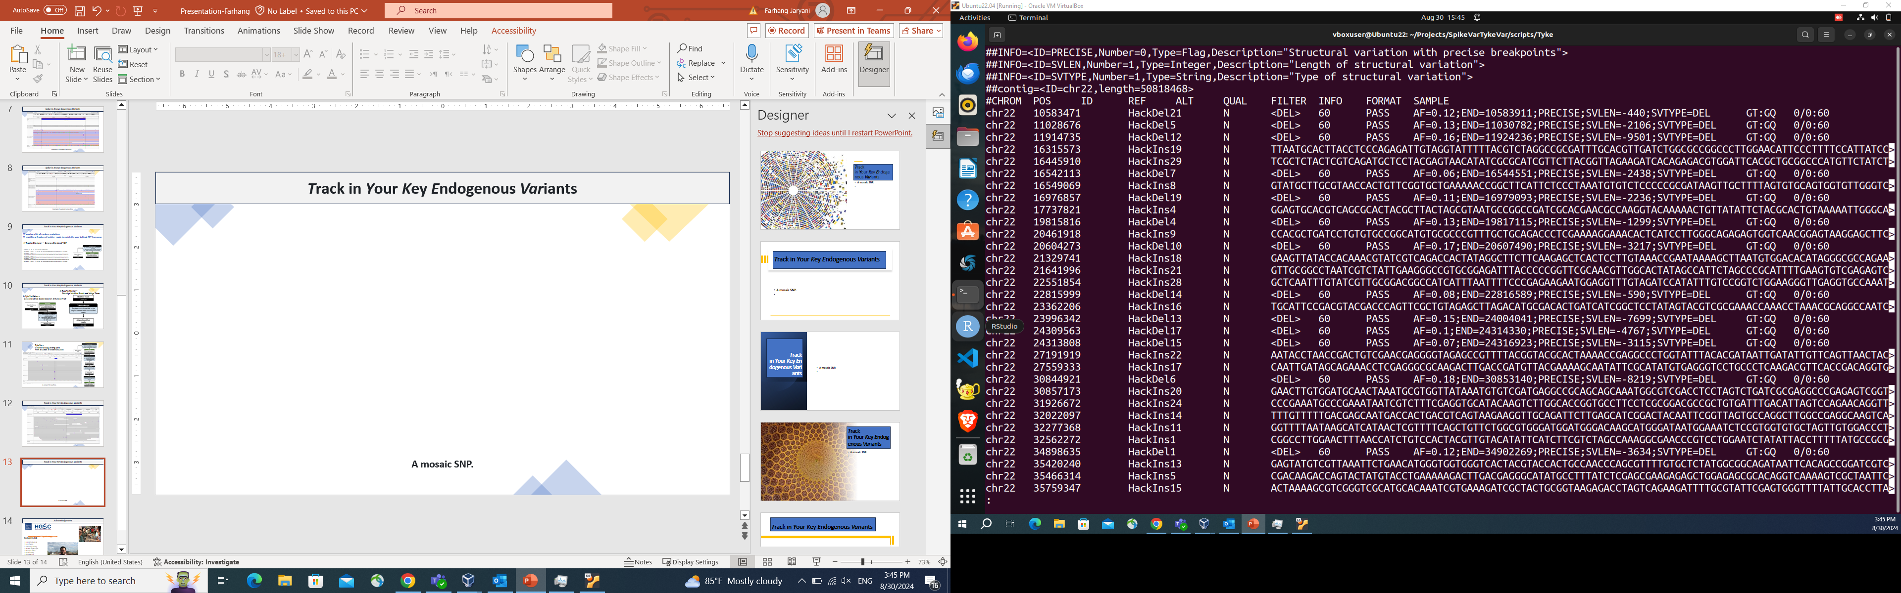
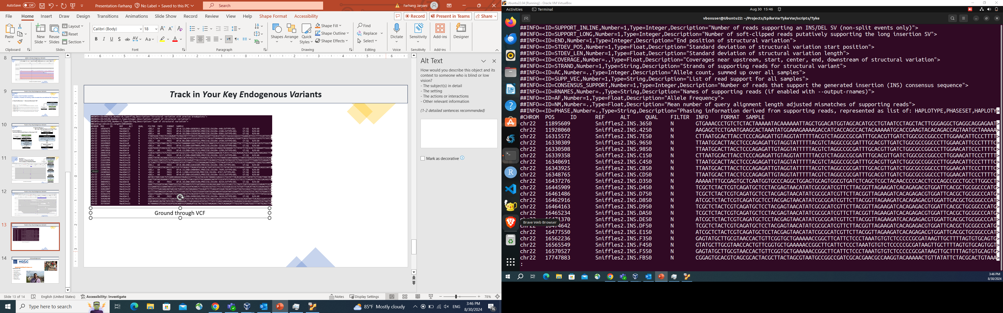
Track in Your Key Endogenous Variants
Ground Truth VCF
Sniffles Mosaic Results

Slide 14


Acknowledgement
Sedlazeck lab
Fritz J Sedlazeck
Luis Paulin
Xinchang Zheng
Michal Izydorczyk
Philippe Sanio
Ryan Cheng
Divya Kalra
Farhang Jaryani

